Slide 1
While you are waiting…
Check your calculator!
Find the square root of 943
Work out $\frac{7}{11}$ of 5676
Work out $−6−3×−7$
30.708…
3612
15

Slide 2
How much change would you get from £10 if you buy six chocolate bars for 89p each and a drink for £1.75?
£2.91
Number : Four Operations

Slide 3
$$−5$$
$$3$$
$$−4$$
Put one number from the list in each box to give the greatest possible answer.
$$3$$
$$−$$
$$−5$$
$$+$$
$$−4$$
$$=4$$
Number : Negative Number

Slide 4
Work out $\frac{7}{5}$ of 6.8
9.52
Number : Fraction of an amount

Slide 5
There are 75 teachers at a school.
18 of the teachers wear glasses.
What fraction of the teachers don’t wear glasses?
Give your answer in its simplest form.
$$\frac{19}{25}$$
Number : One amount as a fraction of another

Slide 6
Which two fractions are equivalent?
$$\frac{8}{12}$$
$$\frac{6}{10}$$
$$\frac{8}{10}$$
$$\frac{15}{25}$$
$$\frac{12}{24}$$
Number : Equivalent fractions

Slide 7
List all the factors of 18
1, 2, 3, 6, 9 and 18
Number : Factors

Slide 8
Find the lowest common multiple of 12 and 18
36
Number : Lowest common multiple

Slide 9
Which of these has the greater value?
$${10.7}^{2}$$
$$\sqrt{10 700}$$
Number : Powers and roots

Slide 10
Write 8165.4738 correct to two significant figures.
8200
Number: Rounding

Slide 11
Use your calculator to work out
$$\frac{0.62×19.4}{\sqrt{5.1}}$$
a) Write down all the figures on your calculator display.
b) Write your answer to part (a) correct to two decimal places.
5.326087922
5.33
Number : Calculator use

Slide 12
Simplify the expressions shown on the cards.
$$k+k$$
$$k×k$$
$$k÷k$$
$$2k$$
$$k^{2}$$
$$1$$
Algebra : Simplification

Slide 13
Expand and simplify $5\left(d+3\right)+2(7−2d)$
$29+d$
Algebra : Expand brackets

Slide 14
Factorise fully ${8x}^{2}−12x$
$$4x(2x−3)$$
Algebra : Factorisation

Slide 15
$$w=10−3u$$
Find the value of $w$ when $u=−2$
$w=16$
Algebra : Substitute values

Slide 16
Make $x$ the subject of each formula $h=\frac{x−3}{5}$
$x=5h+3$
Algebra : Change subject of a formula

Slide 17
A sandwich costs £$s$ and a chocolate bar costs £$c$.
Write an expression for the total cost of buying five sandwiches and three chocolate bars.
$$5s+3c$$
Algebra : Forming an expression

Slide 18
Solve $4+2c=17$
$$c=6.5$$
Algebra: Linear equation

Slide 19
Tommy is $x$ years old.
Dexter is twice as old as Tommy.
Whitney is 5 years younger than Dexter.
The sum of their ages is 35
Form an equation in $x$
$$5x−5=35$$
Algebra: Form an equation

Slide 20
Here are the first 4 terms of a sequence.
4 11 18 25
Find the 10th term of the sequence.
67
Algebra: Linear sequence

Slide 21
Write 195 minutes in hours.
3.25 hours
RPRoC : Time

Slide 22
Mo runs at 5 metres per second.
What is Mo’s speed in kilometres per hour?
18 km/h
RPRoC : Convert compound units

Slide 23
A map is drawn to a scale of 1: 50 000
The distance between two points on the map is 8 cm. Work out the real distance between the two points. Give your answer in kilometres.
4 km
RPRoC : Scale Drawing

Slide 24
Express 45% as a simplified fraction.
$\frac{9}{20}$
RPRoC : Percentage to Fraction

Slide 25
There are 20 bags of crisps in a packet.
6 are cheese, 3 are beef the rest are plain.
What percentage of the crisps are plain?
55%
RPRoC : One quantity as a percentage of another

Slide 26
A pair of shoes costs £45.
The price is decreased by 15% in a sale.
What is the price of the shoes in the sale?
£38.25
Another pair of shoes cost £34 in the sale.
How much did the shoes cost before the sale?
£40
RPRoC : Percentage decrease & Reverse percentage

Slide 27
Dexter and Ron share £40.
Dexter gets £25.
Find the ratio of the amount Dexter has to the amount Ron has, giving your answer in its simplest form.
5 : 3
RPRoC : Write as a ratio

Slide 28
On a school trip, there are 12 teachers and 105 students.
Write the ratio of teachers to students in the form 1 : $n$.
1 : 8.75
RPRoC : 1 : n form

Slide 29
Alex needs 300 g of flour to make 12 pancakes. How much flour does she need to use to make 20 pancakes?
500 g
RPRoC : Direct proportion

Slide 30
Rosie cycles 24 miles in 3 hours.
She then travels a further 18 miles in 2 hours.
What is her average speed for the whole journey?
8.4 mph
RPRoC : Compound measures

Slide 31
Two equilateral triangles are arranged to make the quadrilateral ABCD.
Find the size of $∠$DAB.
A
B
120º
D
C
Geometry: Triangle properties

Slide 32
AB $=$ BC and CD $=$ DA
What is the mathematical name of shape ABCD?
A
B
Kite
D
C
Geometry: Quadrilaterals

Slide 33
Sketch the net of a triangular prism.
Geometry: Triangular prism

Slide 34
A
X
Is AB parallel to XY?
Justify your answer.
110º
112º
No, the corresponding angles are not equal.
68º
B
Y
Geometry: Angles in parallel lines

Slide 35
Work out the size of angle ACB.
16$°$
B
A
74º
C
Geometry: angles in a triangle, vertically opposite angles

Slide 36
The bearing of B from A is 130$°$
Work out the bearing of A from B.
310$°$
A
B
Geometry: Bearings

Slide 37
A triangle has base 10 cm
The area of the triangle is 30 cm²
What is the height of the triangle?
6 cm
Geometry: Area of a triangle

Slide 38
Find the area of the trapezium.
14cm
5cm
4cm
3cm
50 cm²
Geometry: Area of a trapezium

Slide 39
Find the length of AB.
C
40 cm
15 cm
A
B
37.1 cm
Geometry: Pythagoras’ Theorem

Slide 40
A
B
C
D
1
Here is a probability scale.
What is the value of A?
Which letter on the probability scale represents:
i) The probability of rolling a 5 on a fair 6-sided dice.
ii) The probability of a fair coin landing on heads.
0
B
C
Probability: Probability Scale

Slide 41
Colour | Green | Red | Blue | White
Probability | 0.2 | $$x$$ | $$x$$ | 0.5
The table shows the probabilities of a spinner landing on some colours.
a) Work out the value of $x$.
The spinner is spun 60 times.
b) How many times would you expect the spinner to land on green?
0.15
12
Probability: Probability

Slide 42
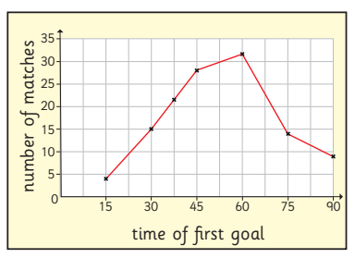
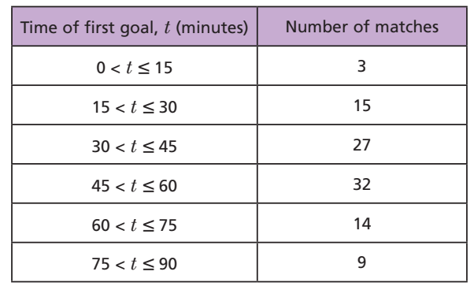
A frequency polygon has been drawn to show the data in the table.
What mistake has been made?
The frequencies should be plotted at the midpoints of the intervals.
Statistics: Frequency polygon

Slide 43
Here are Annie’s scores from a game of ten-pin bowling.
0, 0, 7, 5, 7, 7, 0, 4, 10, 8.
Work out:
a) the range of Annie’s scores.
b) Annie’s median score.
10
6
Statistics: Median and range

Slide 44
The table shows information about the people attending a play at a theatre.
Describe the population attending the theatre.
 | % | Mean age | Range of ages
Male | 33 | 53.2 | 51.8
Female | 67 | 36.7 | 52.1
e.g.
There were more than double the number of females than males
The mean age of the males was much greater
The ranges of the males and females very similar
Statistics: Comparison of distributions.

